Slide 1
Creating a Lie
Inspiration

Slide 2
Gregory Crewdson
Photographer
Uses 8 x 10 film, then scans into Photoshop to edit
Big Productions
Uses a team on set and in post to get desired images

Slide 3
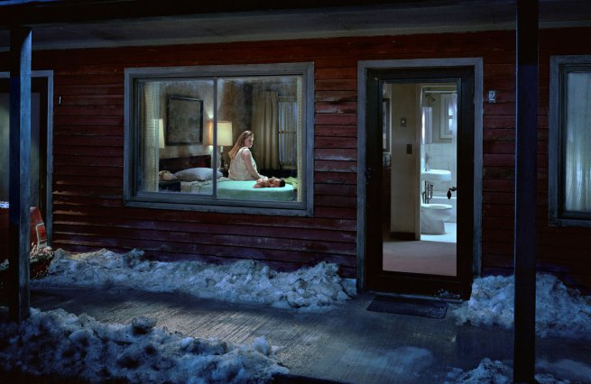
Notes:
Gregory Crewdson Untitled (Birth) from the series ‘Beneath the Roses’ 2007 Digital carbon print 144.8 x 223.5 cm Gregory Crewdson, Courtesy Gagosian Gallery, New York © Gregory Crewdson, 2010

Slide 4
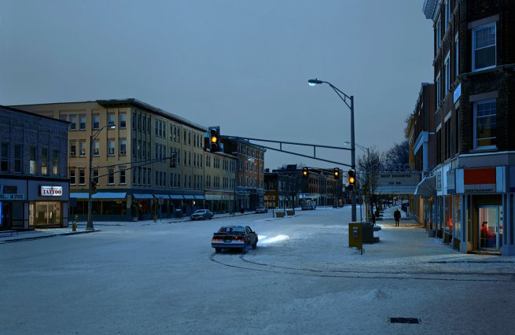
Notes:
Gregory Crewdson Untitled (Brief Encounter) from the series ‘Beneath the Roses’ 2006 Digital carbon print 144.8 x 223.5 cm Gregory Crewdson, Courtesy Gagosian Gallery, New York © Gregory Crewdson, 2010

Slide 5
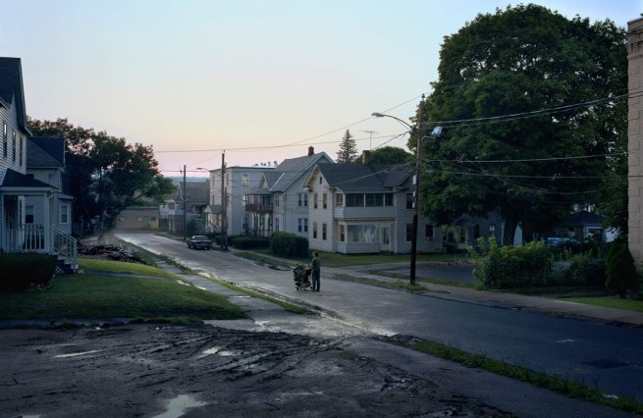
Notes:
Gregory Crewdson Untitled (Kent Street) from the series ‘Beneath the Roses’ 2007 Digital carbon print 144.8 x 223.5 cm Gregory Crewdson, Courtesy Gagosian Gallery, New York © Gregory Crewdson, 2010

Slide 6
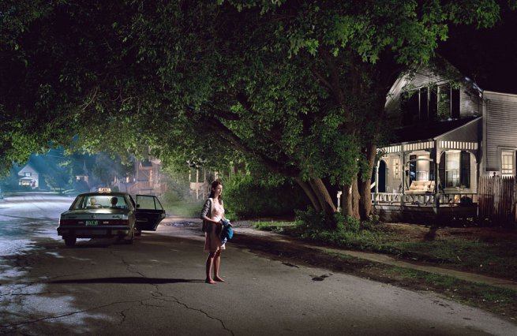
Notes:
Gregory Crewdson Untitled (Maple Street) from the series ‘Beneath the Roses’ Digital carbon print 144.8 x 223.5 cm Gregory Crewdson, Courtesy Gagosian Gallery, New York © Gregory Crewdson, 2010

Slide 7
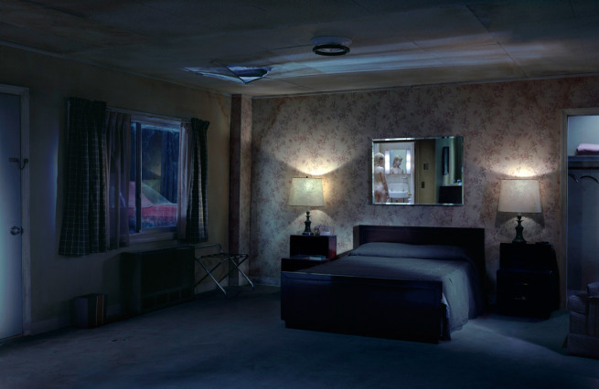
Notes:
Gregory Crewdson Untitled (Debutante) from the series ‘Beneath the Roses’ 2006 Digital carbon print 144.8 x 223.5 cm Gregory Crewdson, Courtesy Gagosian Gallery, New York © Gregory Crewdson, 2010

Slide 8
Thomas Ruff
Uses multiple portraits to create one singular portrait
Nudes series works with the popularity of internet porn to create abstractions

Slide 9
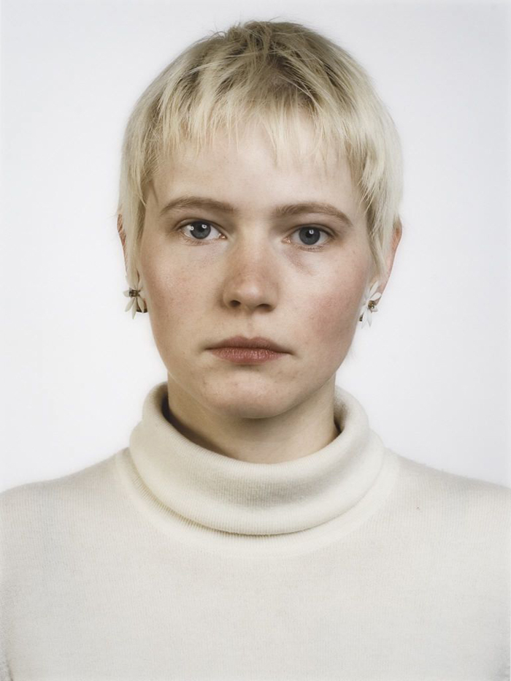
Notes:
http://www.thegorgeousdaily.com/thomas-ruff/

Slide 10
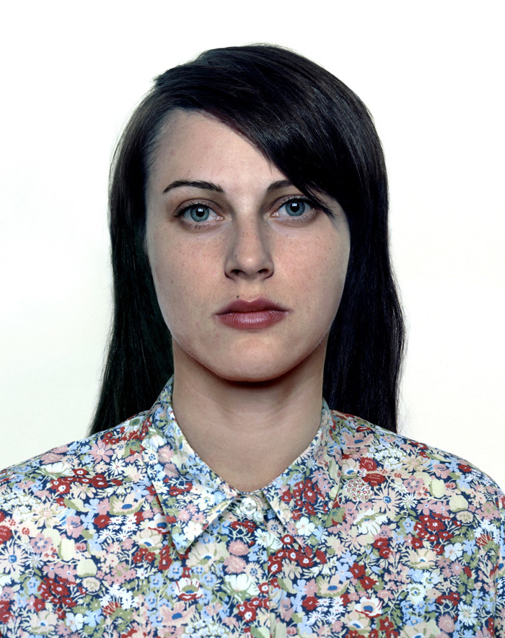
Notes:
http://www.thegorgeousdaily.com/thomas-ruff/

Slide 11
Notes:
Thomas Ruff ree07, 2001 Red Panties
http://www.josephklevenefineartltd.com/NewSite/ThomasRuffNudes.htm#.UeSgTOukBfM

Slide 12
Notes:
Thomas Ruff em08, 2001, Nude Couple
http://www.josephklevenefineartltd.com/NewSite/ThomasRuffNudes.htm#.UeSgTOukBfM

Slide 13
Justin Benzel
Up and Coming Photographer
Chicago, IL

Slide 14
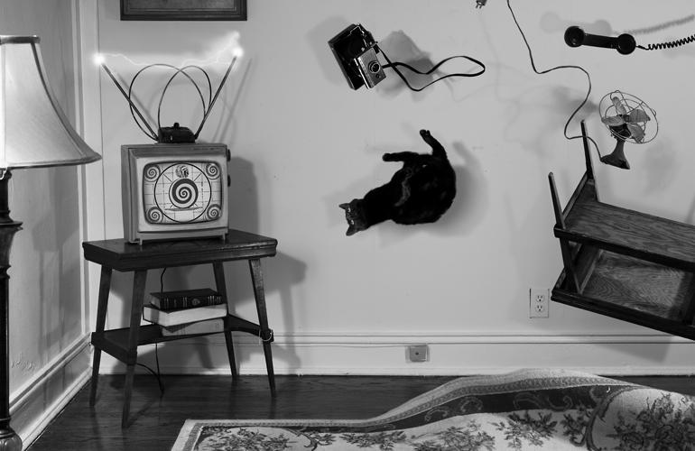
Notes:
Justinbenzel.com

Slide 15
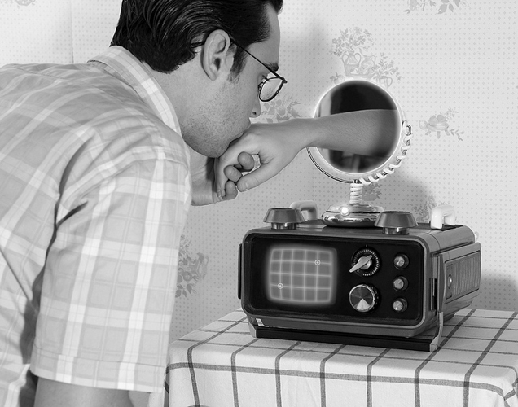
Notes:
Justinbenzel.com

Slide 16
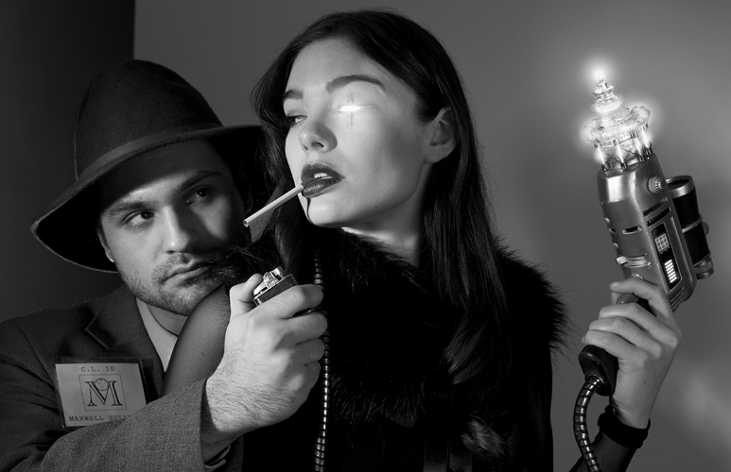
Notes:
Justinbenzel.com

Slide 17
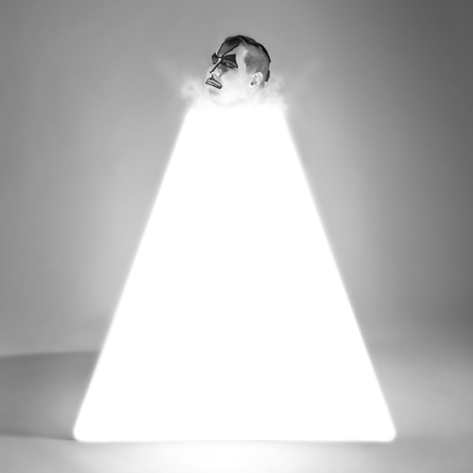
Notes:
Justinbenzel.com

Slide 18
James Dawe
Commercial Artist
London

Slide 19
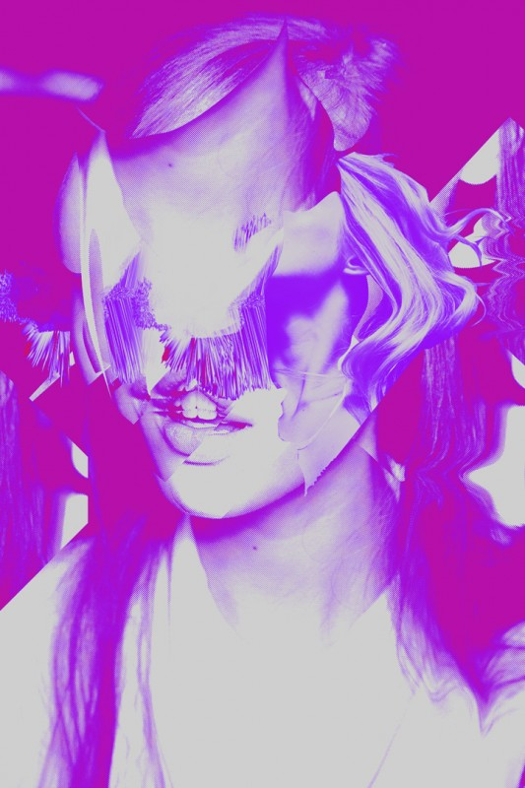

Slide 20
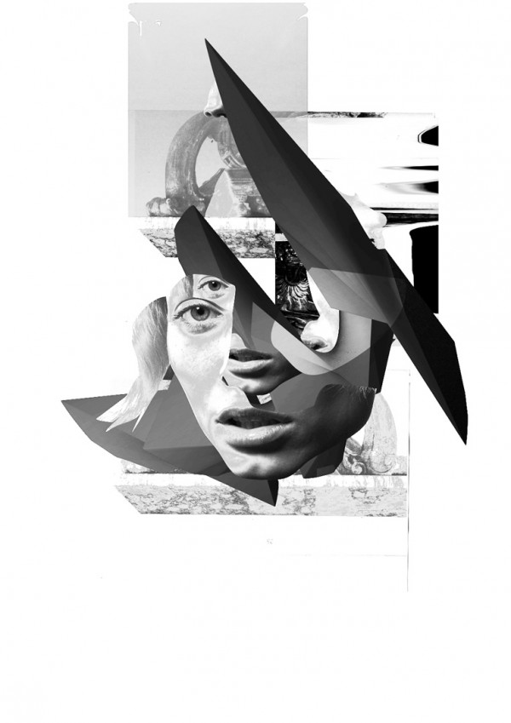

Slide 22
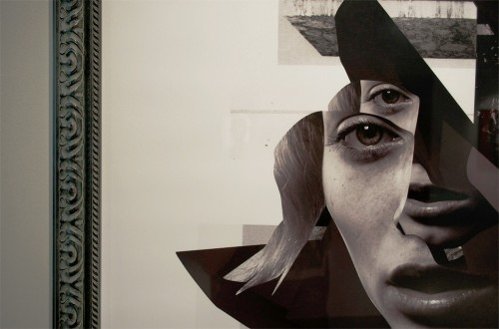

Slide 23
Nir Arieli
Up and Coming Photographer
Recent Graduate from SVA

Slide 24
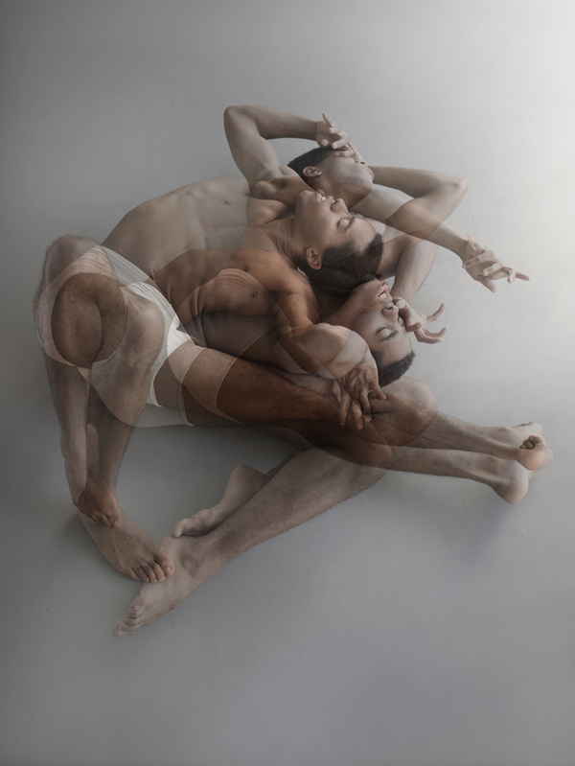
Notes:
Tension Series

Slide 25
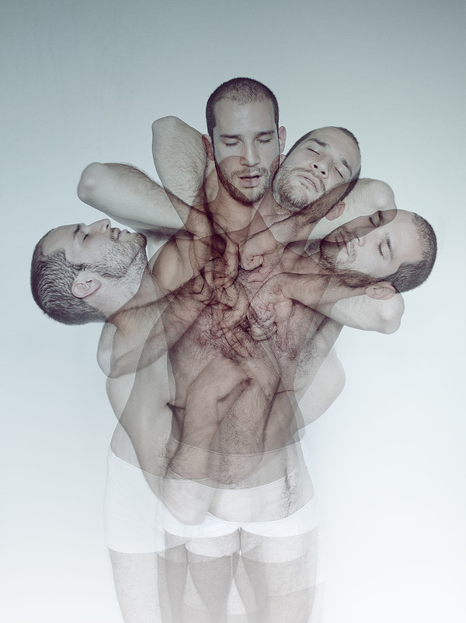
Notes:
Tension series

Slide 26
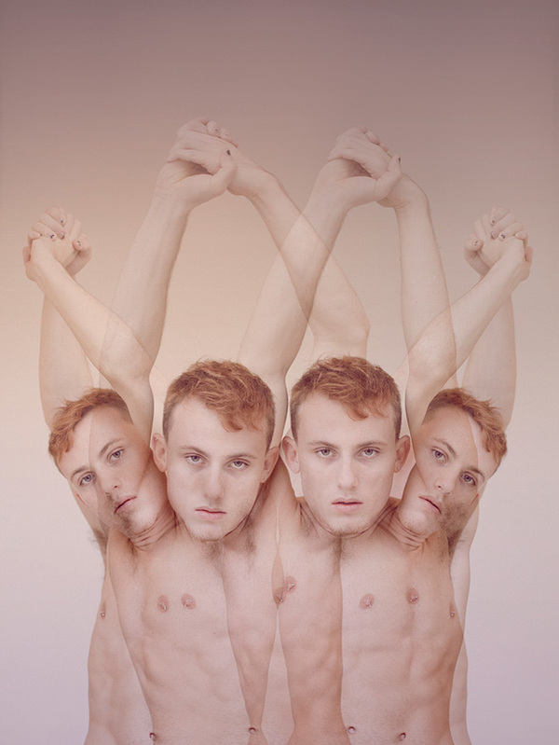
Notes:
Tension Series

Slide 27
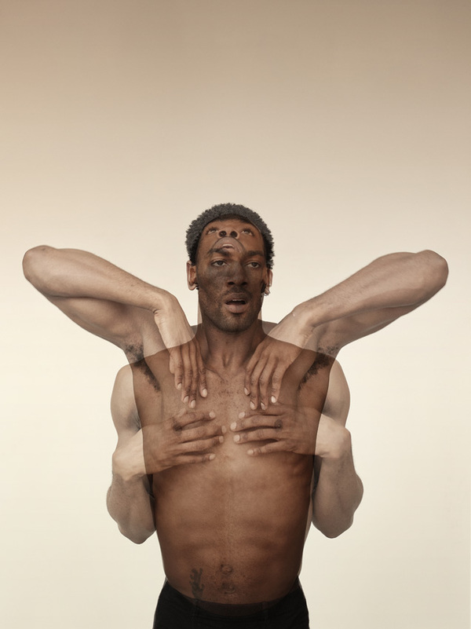

Slide 28
Amy Stein
Constructed from Real Stories
Some Real/Some Fake
Domesticated Series

Slide 29
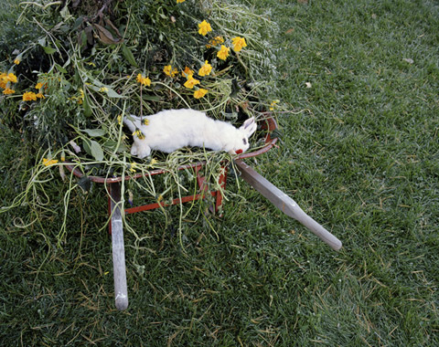

Slide 30
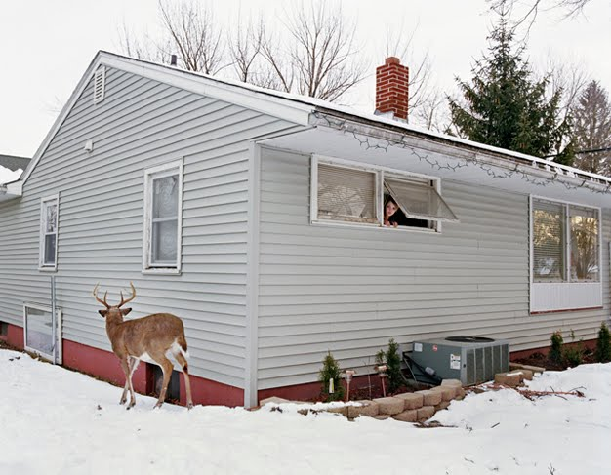

Slide 31
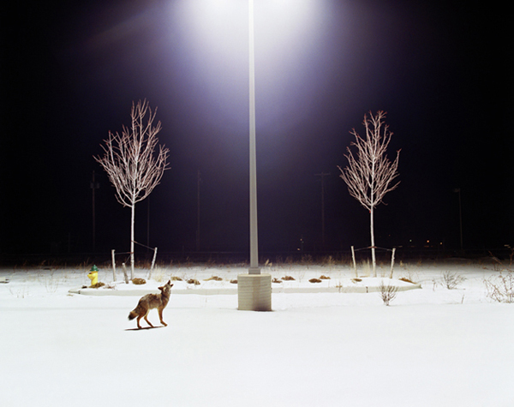

Slide 32
Philippe Halsman
Mid Century Photographer
35mm
Shot Celebrities as well as artists
Close Friendship with Dali
"Some of my colleagues think I damage my reputation as a serious photographer by publishing “silly and tricky” manipulated photographs like the ones I did of Dali -- which mostly expressed abstract ideas. I believe they are wrong."

Slide 33
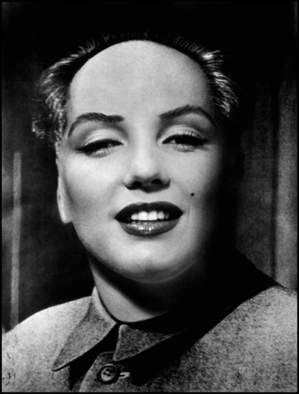
Notes:
http://philippehalsman.com/?image=nudes-experimental

Slide 34
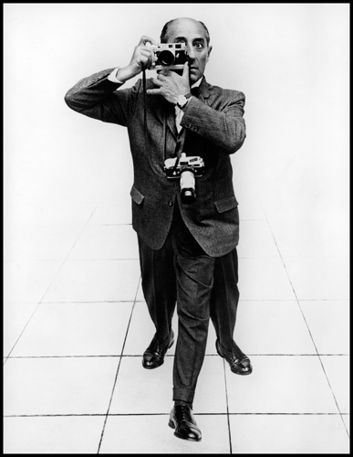

Slide 35
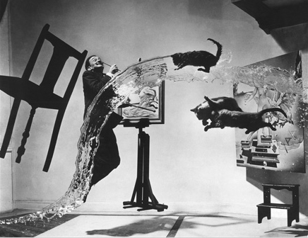

Slide 36
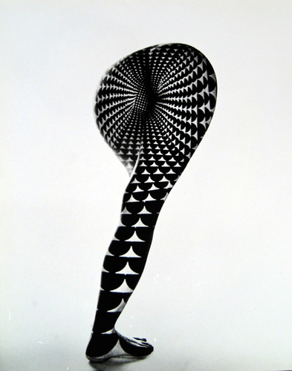

Slide 37
Jee Young Lee
Series “Stage of Mind”
Set building in studio
Self Portraiture
Korean Artist
Notes:
Images from HuffPost

Slide 38
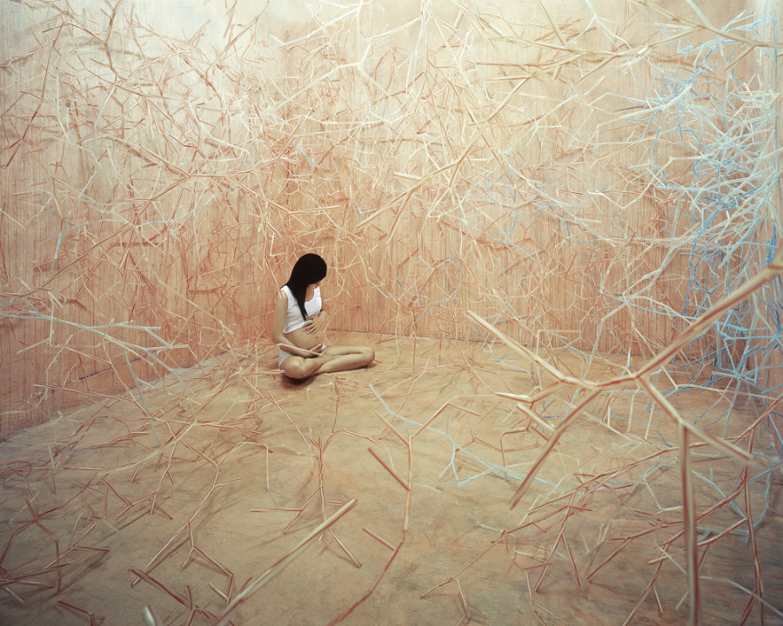
Notes:
“Food Chain”

Slide 39
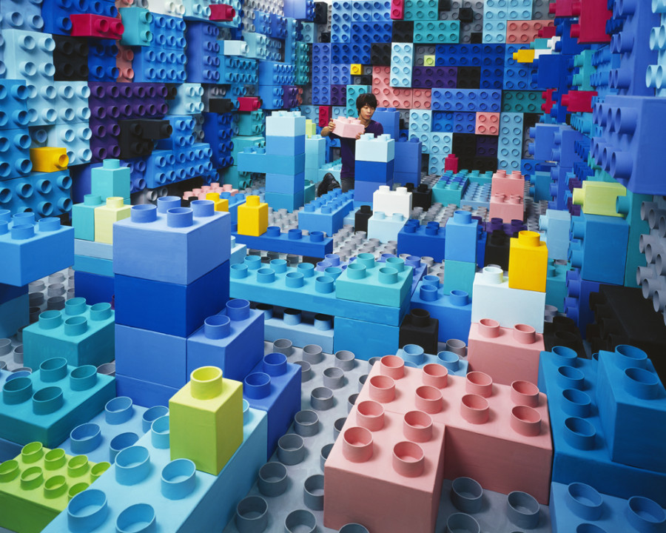
Notes:
“Gamer”

Slide 40
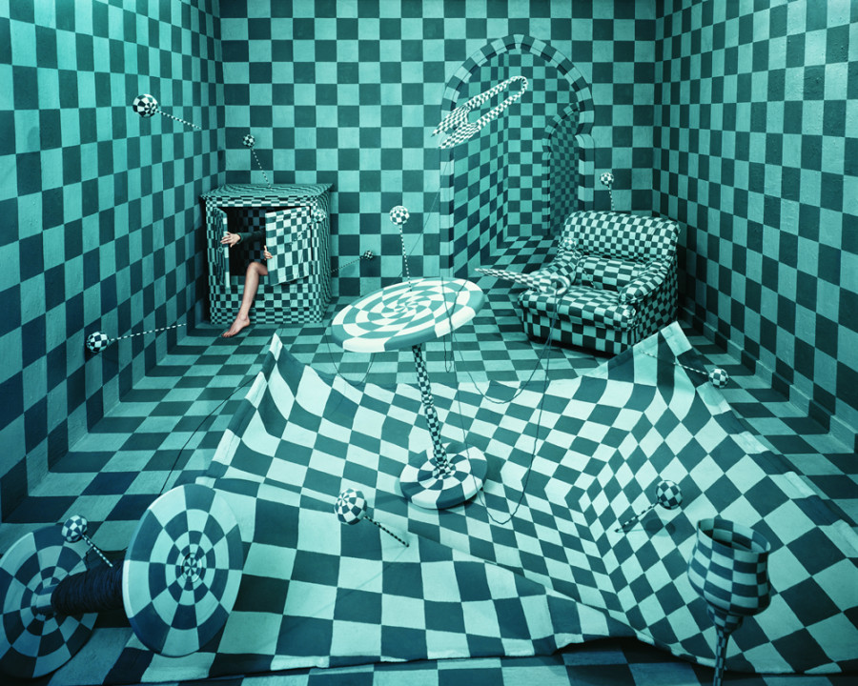
Notes:
"Panic Room," below, takes root in Lee's childhood, when she hid inside closets to escape the world. “To imply the state of emotional chaos, Op art was employed [to express] the messiness of a room; and by turning mere boudoir items or sewing tools into ones that seem aggressive and disquieting,” she writes.

Slide 41
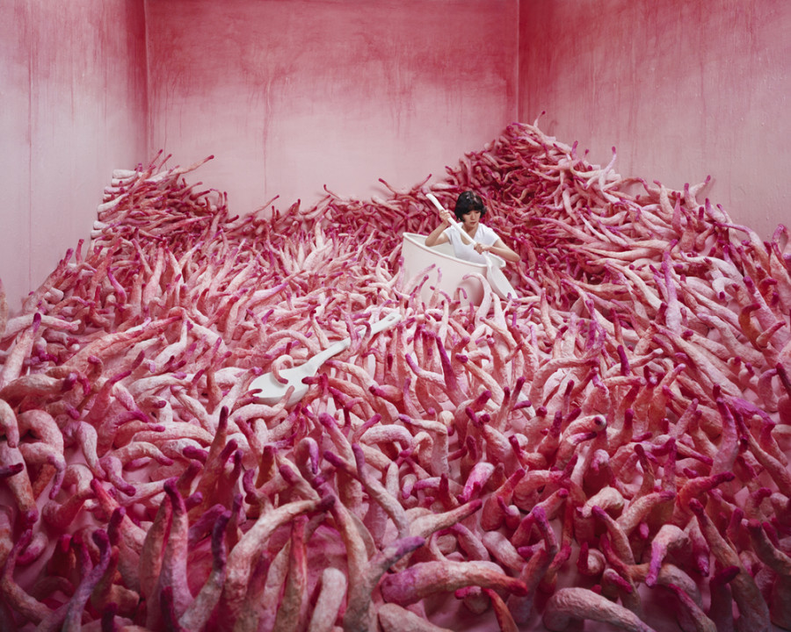
Notes:
Monsoon Season

Slide 42
Daniel Barreto
Boston Based Artist
“Wood houses”
Notes:
http://www.designboom.com/art/daniel-barreto-integrates-urban-windows-and-trees-to-make-woodhouses-11-02-2013/

Slide 43
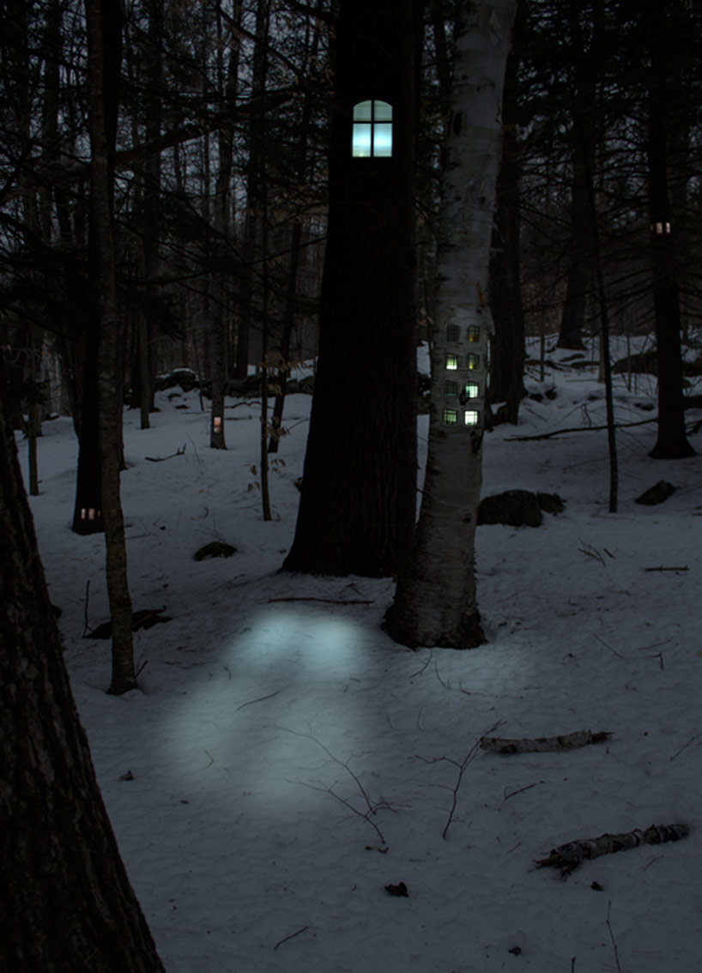

Slide 44
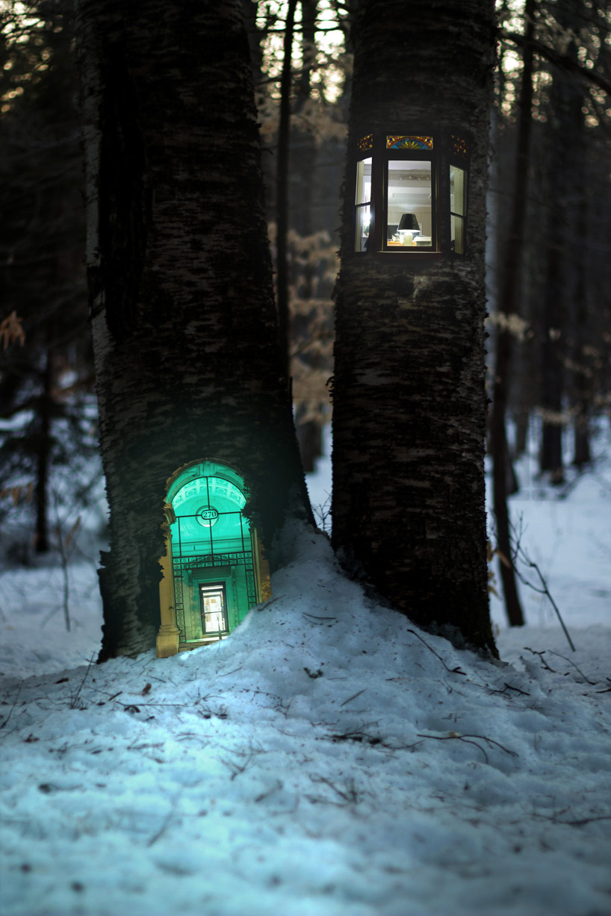

Slide 45
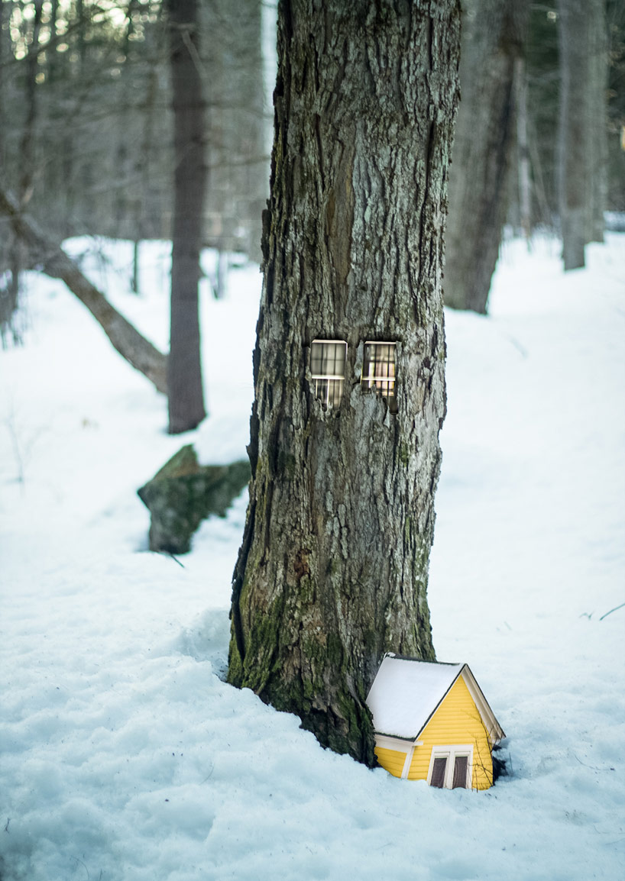

Slide 46
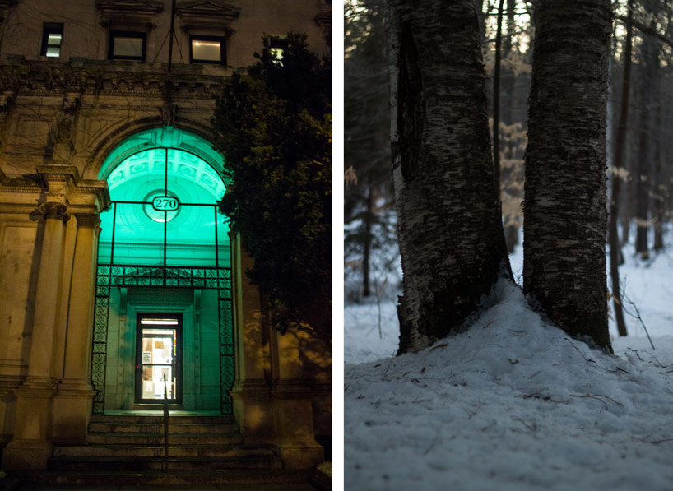

Slide 47
Arthur Tress
Photographer from late 1960s’ to early 1970s
Collaborated with Children with their dreams, both nightmares and fantasies
“Daymares” Series
Staged Photographs, Done “in-camera”
Notes:
http://www.arthurtress.com/
http://www.huffingtonpost.com/2014/07/11/arthur-tress_n_5574740.html

Slide 48
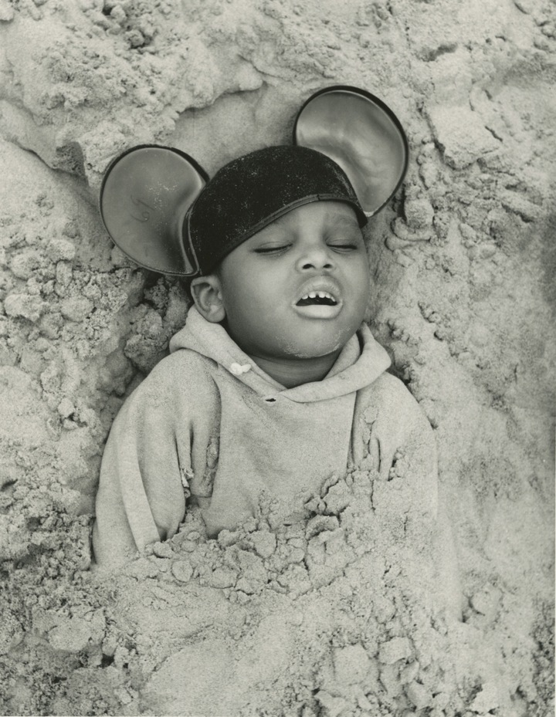

Slide 49
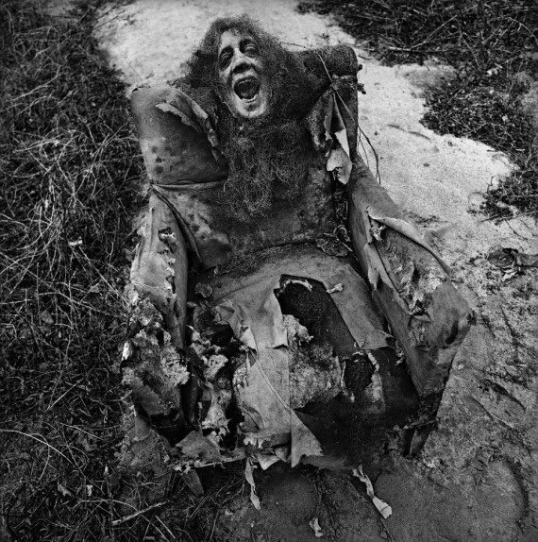

Slide 50
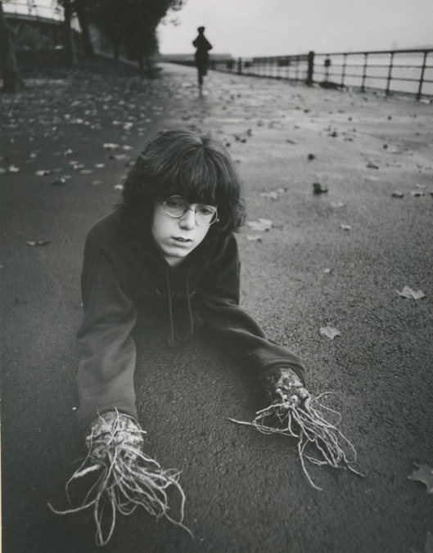

Slide 51
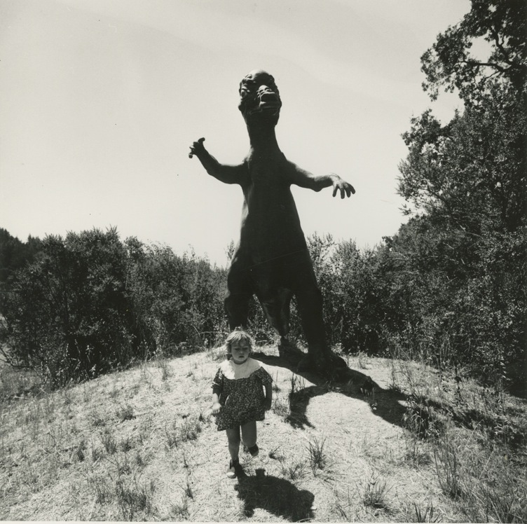

Slide 52
Erin Tyner
“Half Awake”
Notes:
http://www.erintyner.com/half-awake.html

Slide 53
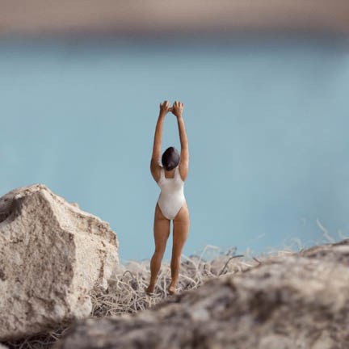
Notes:
“Great Heights”

Slide 54
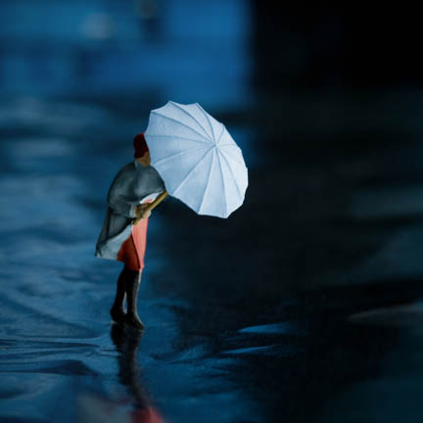
Notes:
“Fade”

Slide 55
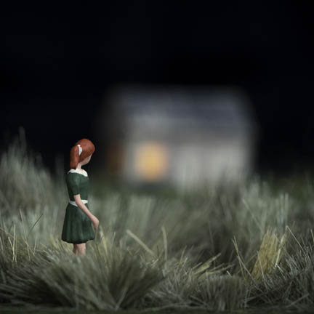
Notes:
“Outskirts”

Slide 56
Nicola Kuperus
Notes:
http://nicolakuperus.com/code/photographs.htm

Slide 57
Notes:
“I Gave up on Sleep”

Slide 58
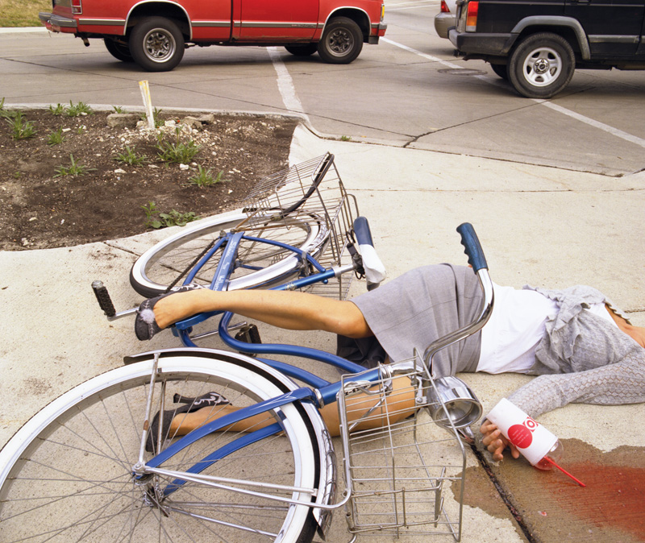
Notes:
“Bike Accident”

Slide 59
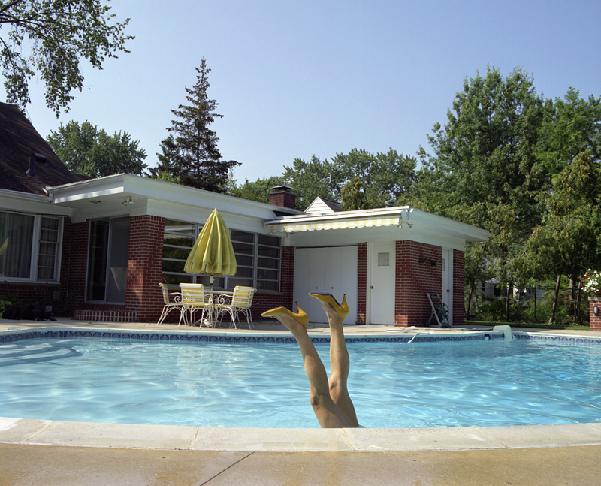
Notes:
“Wet Shoes”

Slide 60
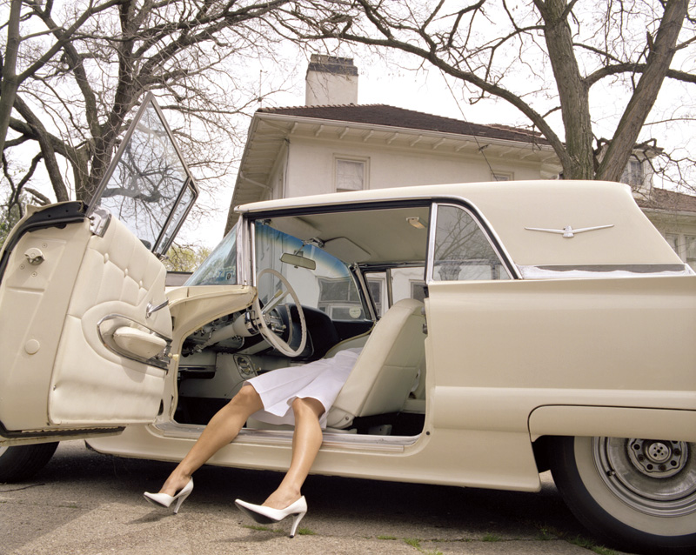
Notes:
“T Bird”

